Slide 1
image to text generator. Subtitle: Exploring Convolutional Neural Networks for Image Recognition and Text Generation
By:
s.Rithika,
613521104035,
Computer science and engineering-third year,
Government collegeof engineering-dharmapuri

Slide 2
outline
Problem statement
Introduction to Image to Text Conversion
Understanding Convolutional Neural Networks (CNN)
Image Recognition with CNN
Introduction to Image Captioning
Model Training
Implementation Example
Results

Slide 3
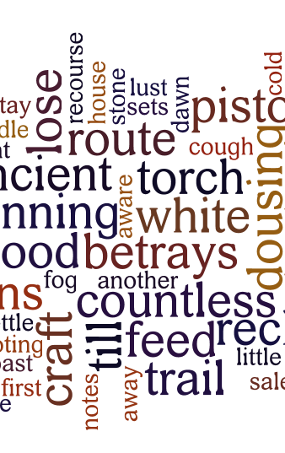
Objective:
Design and develop a deep learning model capable of generating descriptive text captions for given input images.
DATASET USED:
*Pre-trained VGG16 Model
.

Slide 4
Problem Statement:
Given an input image, the task is to automatically generate a human-readable text description that accurately describes the contents and context of the image.
Key Components:
Image Input: The model takes an image as input. This image could be of any size and resolution, representing various scenes, objects, or activities.
Text Output: The output of the model is a textual description (caption) of the input image. The description should be grammatically correct, coherent, and semantically meaningful.
Convolutional Neural Network (CNN): Utilize a CNN architecture to extract features from the input image. The CNN acts as an encoder, transforming the raw pixel values of the image into a compact representation capturing relevant visual features.
Recurrent Neural Network (RNN): Employ an RNN-based decoder to generate the textual description based on the features extracted by the CNN. The RNN generates the caption word by word, taking into account both the visual features and the context of previously generated words.

Slide 5
Introduction to Image-to-Text Converter:
An image-to-text converter, also known as an image captioning system, is an artificial intelligence (AI) model designed to bridge the gap between the visual and textual domains. It takes an image as input and generates a descriptive text caption that encapsulates the content and context depicted in the image.
How does it Work?
At the heart of an image-to-text converter lies a sophisticated neural network architecture, typically composed of two main component.
Convolutional Neural Network (CNN): The CNN serves as the "eyes" of the system, extracting meaningful visual features from the input image. Through multiple layers of convolutions and pooling operations, the CNN learns to identify patterns, shapes, and objects present in the image.
Recurrent Neural Network (RNN): Once the visual features are extracted by the CNN, they are passed on to an RNN-based language model. The RNN acts as the "brain" of the system, generating a textual description of the image one word at a time.

Slide 6
Understanding Convolutional Neural Network (CNN)?
A Convolutional Neural Network (CNN) is a type of deep learning model specifically designed for processing structured grid-like data, such as images. It is inspired by the visual processing mechanisms in the human brain and is highly effective for tasks involving image recognition, classification, and segmentation.
Key Components of CNNs:
Convolutional Layers:
Convolutional layers capture local patterns and features in the input image, such as edges, textures, and shapes.
Pooling Layers:
Pooling layers are used to downsample the spatial dimensions of feature maps generated by convolutional layers.
Activation Functions:
Activation functions, such as ReLU (Rectified Linear Unit), are applied element-wise to the output of convolutional and pooling layers to introduce non-linearity into the model.
Fully Connected Layers:
Fully connected layers, also known as dense layers, are typically found at the end of CNN architectures.

Slide 7
Image recognition with Convolutional Neural Networks (CNNs)
Image recognition with Convolutional Neural Networks (CNNs) is a widely used technique in the field of computer vision. CNNs are particularly effective for tasks such as object recognition, image classification, and image segmentation. Here's a basic outline of how image recognition with CNNs works:
Data Collection and Preprocessing
Model Architecture
Training
Evaluation
Fine-tuning and Hyperparameter Tuning
Deployment.

Slide 8
Image captioning & Model Training :
Image captioning is a task in computer vision and natural language processing (NLP) that involves generating textual descriptions for images. The goal is to create a system that can automatically generate human-like captions that accurately describe the content of images.
Here's an introduction to image captioning and the process of training a model for image-to-text generation:
Dataset Collection and Preprocessing
Model Architecture
Training
Evaluation
Deployment

Slide 9
Implementation:
Implementing a text-to-image generator involves creating a model that takes textual descriptions as input and generates corresponding images. This task is considerably more challenging than image captioning, as it requires synthesizing images from textual descriptions, which involves understanding and translating the semantics of the text into visual features.
here the implenetation process has been successfully implemented by using the Pre-trained VGG16 Model
.

Slide 10
Result:
the given program to execute image ot text has been compiled & the output predicts the texts which is present in the image.
thank you.

